Slide 1

Nuclei Segmentation using U-Net with EfficientNet-B3 Encoder
Advancing Medical Image Analysis Through Deep Learning
Presented By
Under the Guidance of
Chaman Yadav - 2204212
Dr. Shitala Prasad
Suryansh Humane - 2203328
Department of Computer Science & Engineering
Indian Institute of Technology Goa
Yash Singh Bhadauria - 2203139

Slide 2
Project Overview: End-to-End Nuclei Segmentation
This project focuses on separating and identifying cell nuclei in microscope images. This step is very important in biology and medical research. When we clearly detect and outline each nucleus, it becomes easier to do further analysis like counting cells, studying their shapes, and tracking how a disease is developing. The pipeline is built to be reliable and accurate, using modern deep-learning methods to get strong results.
Advanced Architecture
RLE Mask Handling
Utilizes a UNet architecture renowned for its effectiveness in biomedical image segmentation, enhanced by an EfficientNet-B3 encoder for superior feature extraction.
The training data uses RLE, which is a short way to store mask information. Instead of saving every pixel, RLE saves the mask as start positions and lengths.
Comprehensive Evaluation
Broad Applicability
We carefully check the model’s performance using standard metrics like Loss, Dice Score, and Intersection over Union (IoU). We also look at the predicted masks visually to understand how well the model is working.
It creates clear segmentation masks for the Test dataset, showing that the model can work well on different sets of images.

Slide 3
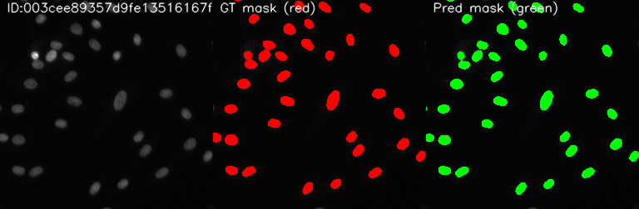
Dataset Structure
The project processes microscopy images organized into clear directories for training and evaluation.
Directory Structure
Train.csv – Training masks in RLE format. test_solution.csv – Ground truth for test evaluation. submission.csv – Model predictions for Test set. submission_test2.csv – Model predictions for Test2 set. unet_effnet_nuclei.pth – Saved trained model weights.
data/Train/ – Training images by ImageId. data/Test/ – Test images for prediction. data/Test2/ – Second test set for prediction.
training_visuals/ – Saved input/GT/prediction grids. training_plots/ – Loss and Dice metric graphs.
main.py – Full training and inference code.
project/
│── Train.csv
│── test_solution.csv
│── submission.csv
│── submission_test2.csv
│── unet_effnet_nuclei.pth
│
│── data/
│ ├── Train/<ImageId>/images/*.png
│ ├── Test/<ImageId>/images/*.png
│ └── Test2/<ImageId>/images/*.png
│
│── training_visuals/ (epoch visual outputs)
│── training_plots/ (loss & dice plots)
│
└── main.ipynb

Slide 4
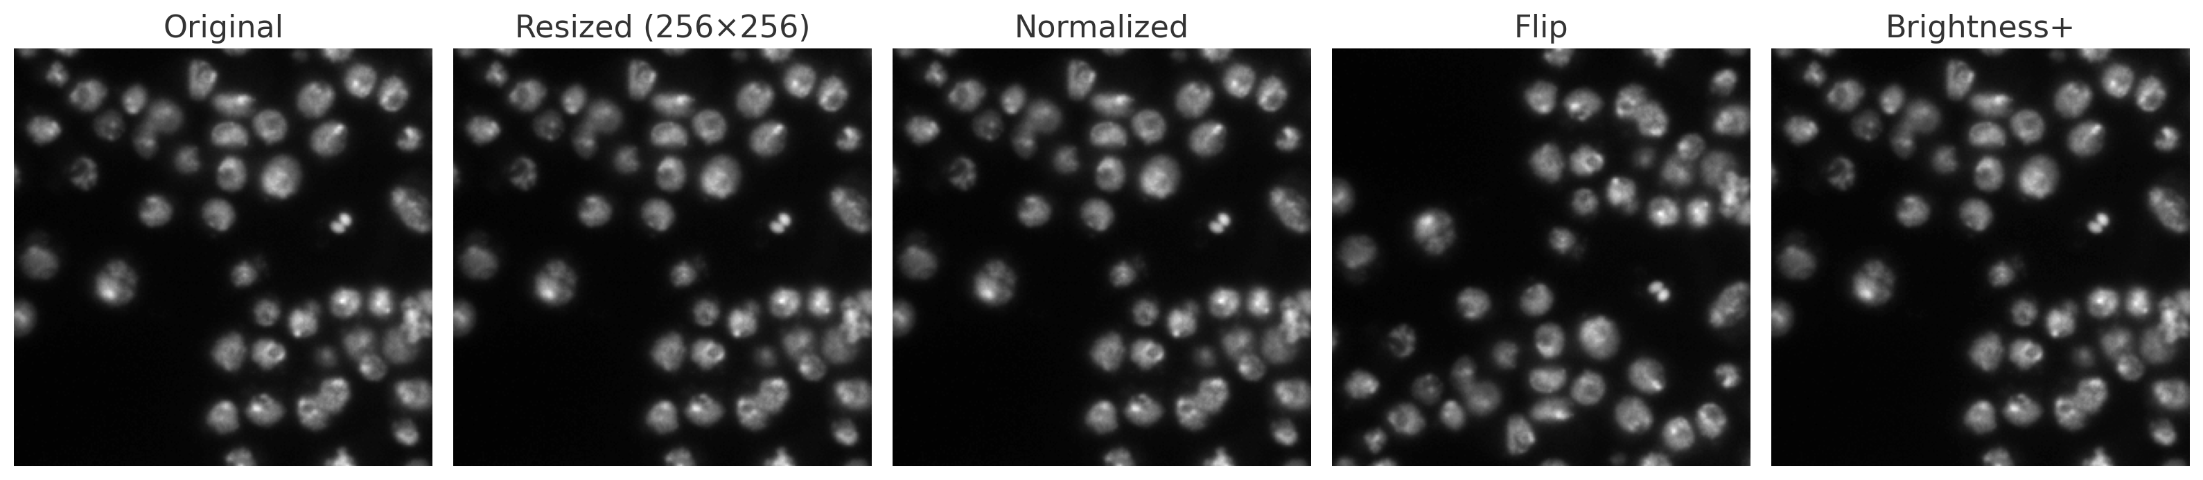
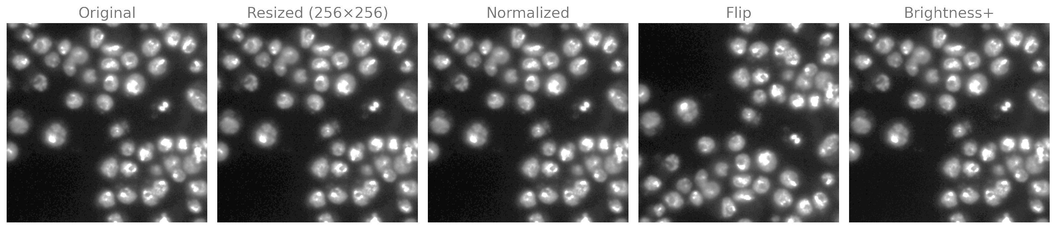
Preprocessing Essentials
A robust preprocessing pipeline ensures that images are uniformly prepared for optimal model performance.
Key Preprocessing Steps
Albumentations Pipeline Summary
Resize: All input images are uniformly resized to 256x256 pixels to standardize input dimensions for the neural network.
Flips: Horizontal and vertical flips introduce spatial variations.
Rotation: Random rotations enhance robustness to object orientation changes.
Normalization: Images are normalized using ImageNet mean and standard deviation, aligning pixel value distributions with pre-trained models.
Brightness/Contrast: Adjustments simulate varying lighting conditions.
Augmentations: A comprehensive suite of augmentations from the Albumentations library is applied to enhance model generalization and prevent overfitting.
Scale/Shift: Minor scaling and shifting further diversify the training data.
(512x512)

Slide 5


Understanding Run-Length Encoding (RLE) for Masks
Run-Length Encoding (RLE) is a simple way to compress an image mask by saying how many identical pixels appear in a row instead of listing every pixel individually. It is especially good for binary masks (images where each pixel is either background = 0 or object = 1) that have large uniform areas (big chunks of 0s or big chunks of 1s). Instead of storing every pixel, RLE stores the lengths of consecutive runs of the same value. That saves space when many neighboring pixels are identical.
Efficiency in Storage
Decoding for Training
Encoding for Submission
RLE dramatically reduces the storage footprint of segmentation masks, especially for sparse or highly structured masks, which is common in medical imaging.
During the training phase, RLE strings are decoded to reconstruct full pixel masks. These binary masks serve as the ground truth for the UNet model's learning process.
After inference, the predicted binary masks from the model are re-encoded back into RLE format. This standardized format is required for efficient storage of results.
Conceptual Visual Example: RLE → Mask
Imagine a row of pixels: 00011110011. Its RLE representation might be 3 4 2 2 (3 zeros, 4 ones, 2 zeros, 2 ones) or similar, depending on the specific RLE standard. This compact string is then expanded back into a full pixel array for training or visualization.

Slide 6
Custom NucleiDataset & DataLoader Implementation
A custom Dataset class, NucleiDataset, is central to efficiently loading and preparing image and mask data for the training pipeline. It handles the complexities of combining multiple RLE entries into a single ground truth mask and provides a consistent interface for the DataLoader.
Handling Test Data
Image & Mask Loading
For test sets (Test/ and Test2/), where ground truth masks are not available, the dataset intelligently generates blank masks. This ensures a consistent output format (image, mask, image_id) across all dataset types, simplifying the inference pipeline.
The NucleiDataset loads the microscopy image and its corresponding ground truth mask. For images with multiple nuclei, all individual RLE entries associated with that image are decoded and combined to form a single, multi-channel or aggregated binary mask.
DataLoader Setup
Output Format
The DataLoader is configured with a batch size of 8, enabling efficient parallel processing during training. The num_workers parameter is set to 0, indicating that data loading is handled in the main process, suitable for smaller datasets or debugging.
Each call to the dataset's __getitem__ method returns a tuple: the preprocessed image tensor, the combined ground truth mask tensor, and the unique identifier of the image.
This setup ensures that the model receives data in optimized batches, accelerating training and reducing memory overhead.

Slide 7
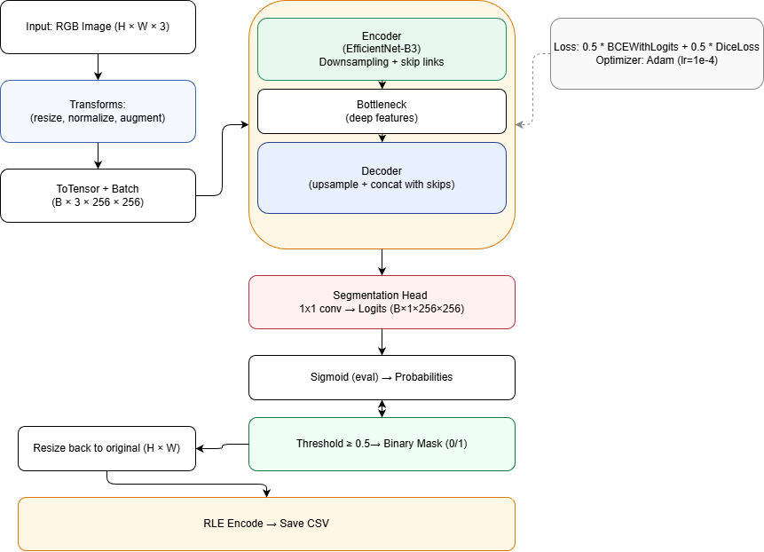
UNet Model with EfficientNet-B3 Encoder
The segmentation model is built upon the powerful segmentation_models_pytorch (SMP) library, offering a highly modular and customizable approach. Our choice of EfficientNet-B3 as the encoder vastly improves feature extraction capabilities compared to traditional UNet encoders.
Model Architecture
Library: segmentation_models_pytorch (SMP) provides a robust framework for implementing segmentation models.
Encoder: EfficientNet-B3 is chosen for its superior balance of depth, width, and resolution scaling, leading to efficient and powerful feature learning. It is pre-trained on ImageNet to leverage learned hierarchical features from a vast general dataset, accelerating convergence and boosting performance on our specific task.
Decoder: A classic UNet-style decoder is employed, consisting of a series of upsampling blocks that gradually recover spatial information from the encoder's feature maps, culminating in a high-resolution segmentation mask.
Output Layer: The final layer produces a single-channel mask activated by a sigmoid function, yielding pixel-wise probabilities for nuclei presence.

Slide 8


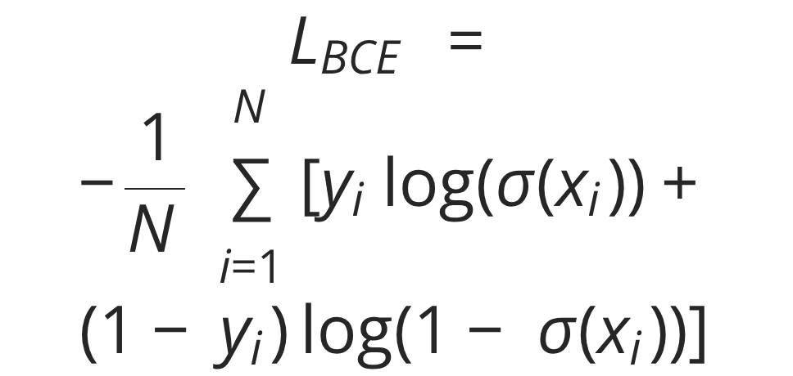

Loss Function & Optimizer
Hybrid Loss: To achieve optimal segmentation, a hybrid loss function is used, combining Binary Cross-Entropy (BCE) Loss for pixel-wise classification and Dice Loss to handle class imbalance and focus on overlap accuracy.
Optimizer: The Adam optimizer is selected for its efficiency and effectiveness in training deep neural networks, configured with an initial learning rate (LR) of 1e-4.
Epochs: The model is trained for 80 epochs to allow for sufficient convergence and fine-tuning.
Binary Cross-Entropy with Logits (BCEWithLogitsLoss)
Dice Coefficient & Dice Loss
Combined Loss
We use a weighted sum of BCE and Dice Loss. Recommended weights: α=0.5, β=0.5.
Effectively handles class imbalance by focusing on the overlap between prediction and ground truth.
Standard for binary classification, applies sigmoid internally for numerical stability.

Slide 9
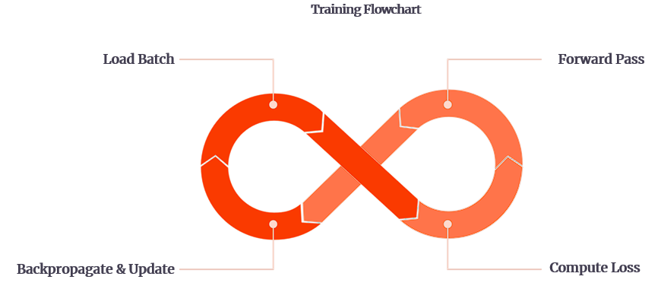
The Training Loop: Cultivating Segmentation Accuracy
The training loop orchestrates the learning process, iteratively refining the model's parameters to accurately segment nuclei.
It systematically processes data in batches, computes loss, updates weights, and monitors progress through various metrics and visualizations.
01
Batch-wise Processing
Data is fed to the model in mini-batches. For each batch, the images undergo a forward pass through the UNet model to generate predicted masks.
02
Loss & Metric Calculation
The predicted masks are compared against the ground truth masks to calculate the hybrid loss (BCE + Dice). Simultaneously, the Dice score is computed to provide an interpretable measure of segmentation accuracy.
03
Backpropagation & Optimization
The calculated loss is used to compute gradients via backpropagation. The Adam optimizer then uses these gradients to update the model's weights, aiming to minimize the loss in subsequent iterations.
04
Progress Tracking
tqdm is integrated to provide a dynamic and informative progress bar, offering real-time feedback on the training status, including elapsed time and estimated time remaining per epoch.
05
Checkpointing & Visualization
Model checkpoints are saved every 10 epochs, ensuring that training progress can be resumed if interrupted. Additionally, visual grids of predictions are saved every 5 epochs to qualitatively monitor segmentation improvements. Epoch-wise loss and Dice scores are also recorded for post-training analysis and plotting.
Compute Loss

Slide 10

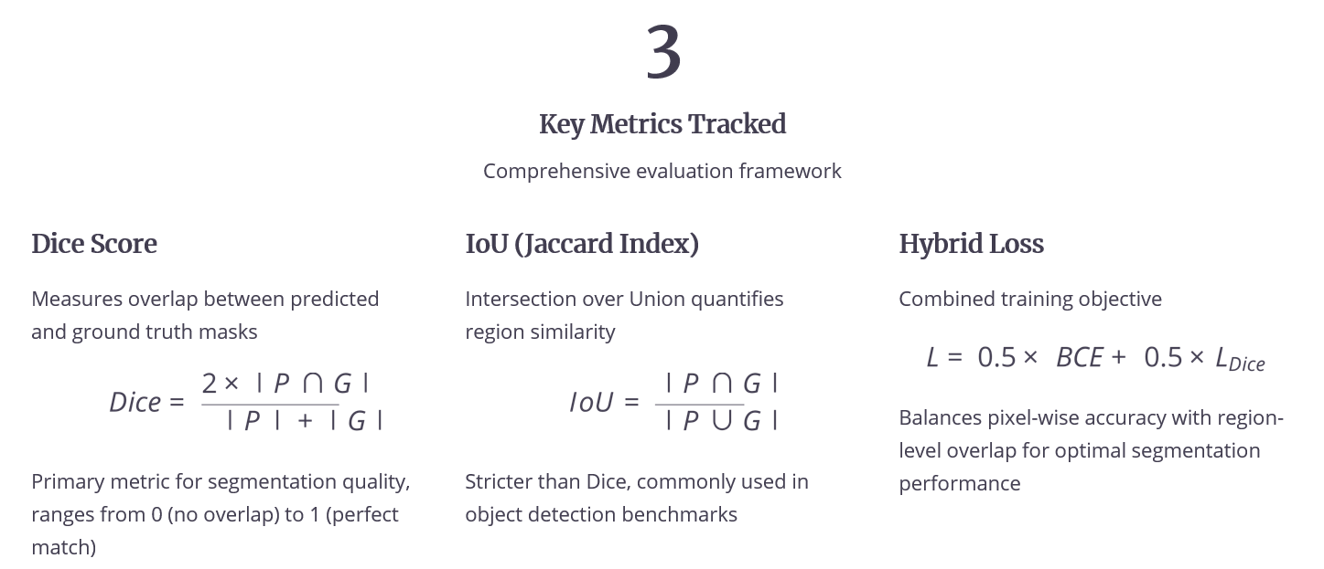
Visualization & Training Metrics: Insight into Performance
Visualizing predictions and tracking metrics throughout training are crucial for understanding model behavior, identifying potential issues, and validating performance. This pipeline generates both qualitative and quantitative insights.
Visual Grids of Sample Predictions
To provide immediate qualitative feedback on segmentation performance, the pipeline generates visual grids for a small set of sample images at regular intervals. Each grid displays:
Input Image: The original microscopy image.
Ground Truth (Red Overlay): The true nuclei masks, overlaid in red, showing what the model should ideally predict.
Prediction (Green Overlay): The model's predicted nuclei masks, overlaid in green, allowing for direct comparison with the ground truth.
These visualizations are vital for assessing mask quality, boundary accuracy, and identifying false positives or negatives.

Slide 11
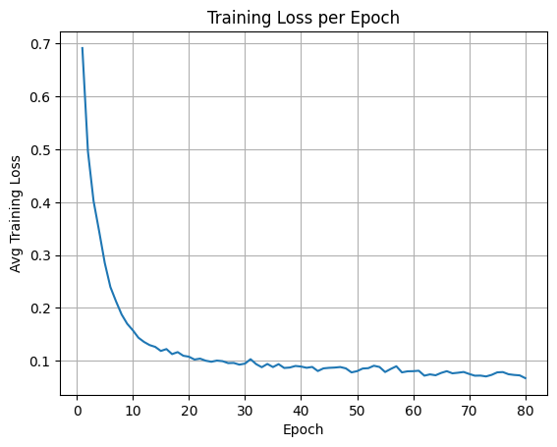
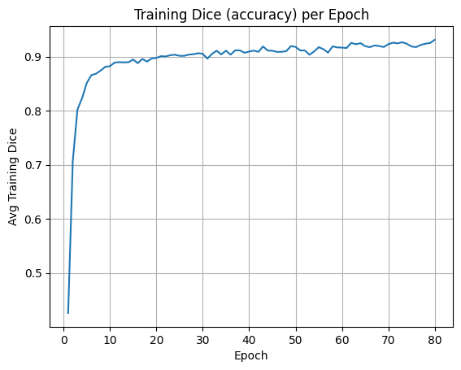
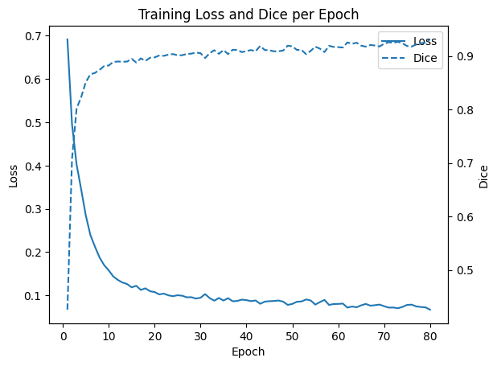
Visualization & Training Metrics: Insight into Performance
Visualizing predictions and tracking metrics throughout training are crucial for understanding model behavior, identifying potential issues, and validating performance. This pipeline generates both qualitative and quantitative insights.
Training Metrics Plots
Quantitative metrics are meticulously recorded and plotted to illustrate the model's learning trajectory and convergence:
Combined Plot: A single, comprehensive plot integrating
both loss and Dice score trends, providing
a holistic view of training performance.
Dice vs. Epoch: A plot illustrating the Dice score's progression
per epoch. An increasing trend signifies improving
segmentation accuracy.
Loss vs. Epoch: A plot showing the trend
of the hybrid loss function over each training
epoch. A steady decrease indicates effective learning.

Slide 12






Inference Pipeline: Applying the Trained Model
Once the model is trained and validated, the inference pipeline is executed to generate segmentation masks for unseen images in the Test/ and Test2/ datasets. This process meticulously handles each image from loading to final RLE submission.
Loading Images
Each image from the specified inference directory (Test/ or Test2/) is loaded individually for processing. This ensures that the model can handle diverse image sizes and characteristics.
Preprocessing
The loaded image undergoes the same preprocessing steps as the training data: resizing to 256x256 and normalization using ImageNet statistics. This consistency is critical for the model to make accurate predictions.
Model Inference
The preprocessed image is fed into the trained UNet + EfficientNet-B3 model. The model outputs a single-channel prediction map, representing the probability of each pixel belonging to a nucleus.
Resizing to Original
The predicted mask, which is 256x256, is resized back to the original dimensions of the input image. This step is essential to ensure that the segmentation output corresponds correctly to the original image context.
Thresholding & Binarization
A threshold of 0.5 is applied to the probability map. Pixels with probabilities above 0.5 are classified as nuclei (1), and those below are classified as background (0), resulting in a crisp binary mask.
RLE Conversion
The final binary mask is then converted back into the compact Run-Length Encoding (RLE) format. This format is efficient for storage and is typically required for competition submissions or specific data handling.
Submission File Generation
All generated RLE strings for each image are compiled into a submission.csv file, listing Image IDs and their corresponding RLE masks, ready for evaluation or further analysis.
This entire sequence is encapsulated within the run_inference_on_dir() function, automating the process for batch inference.

Slide 13
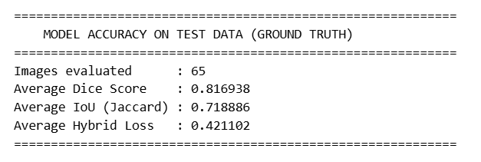



Evaluation & Final Results: Quantifying Segmentation Success
The final phase involves a comprehensive evaluation of the model's performance on unseen data, comparing its predictions against ground truth to derive key metrics. These metrics confirm the effectiveness of our UNet with EfficientNet-B3 approach.
Robust Evaluation Metrics
The model's performance is rigorously assessed using a suite of standard segmentation metrics:
Dice Score: The Dice score measures the similarity between the predicted and
ground-truth masks. The test evaluation reports an Average Dice Score of 0.816938,
indicating a good level of overlap and consistent segmentation quality.
Hybrid loss : Hybrid loss provides insight into the combined error during evaluation. The test results show an Average Hybrid Loss of 0.421102, reflecting a
balanced contribution of both loss components.
IoU (Intersection over Union): IoU quantifies the ratio of overlapping area to the total combined area of the predicted and ground-truth masks. The test data reports an Average IoU of 0.718886, demonstrating reliable spatial accuracy in the segmentation output.
Enhanced Feature Extraction
Strong Segmentation Performance
Accurate Visual Results
The integration of EfficientNet-B3 as the UNet encoder significantly improves the model's ability to extract complex and relevant features from microscopy images, leading to more discriminative segmentation boundaries.
The model demonstrates strong overall performance across all evaluated metrics, showing precise and reliable nuclei segmentation results.
Qualitative visual results confirm that the model correctly outlines nuclei boundaries, even in challenging cases with irregular shapes or clustered nuclei, showcasing robust generalization.
This project successfully demonstrates an end-to-end pipeline for high-quality nuclei segmentation, leveraging advanced deep learning architectures and comprehensive evaluation techniques.

